Slide 1
MAPS II Atlas of the Sahara -Sahel
Chapters 2-10
www.oecd.org/swac/maps
Notes:
1. Who we are 2. Activities 3. Funding
Reminder of process of elaboration of this PWB:
Preliminary consultation with West African regional organisation in Paris on 16 April 2014
Discussion of draft PWB with Members in Strategy and Policy Group meeting on 17 june; approval in principle of proposed orientations and activities
Finalisation of financing plan with Members and partners, circulation of final version to Members for approval by written procedure in October. Final approval date 3 November 2014.

Slide 2
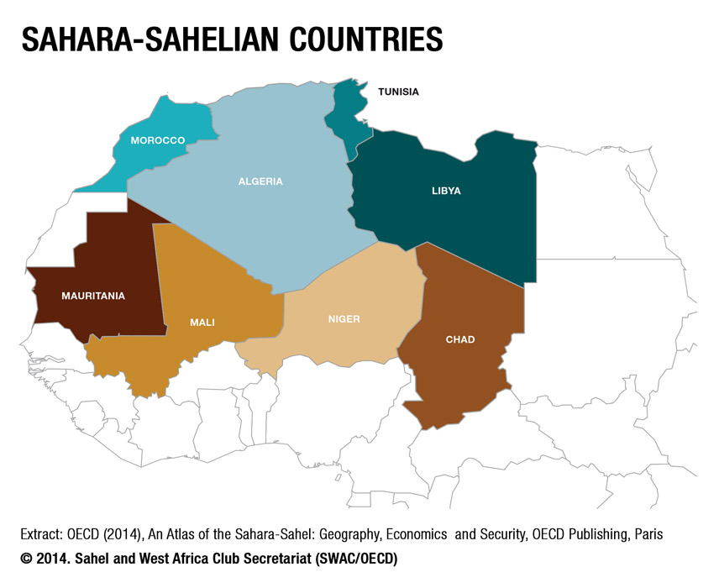

Slide 3
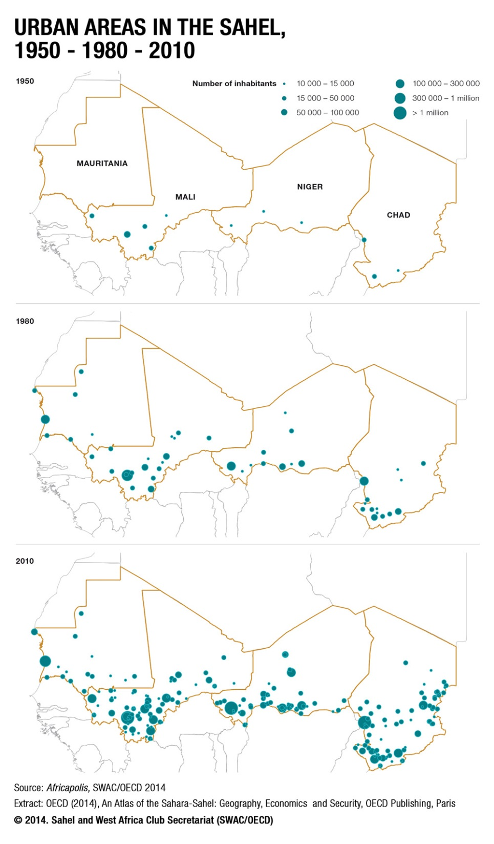

Slide 4
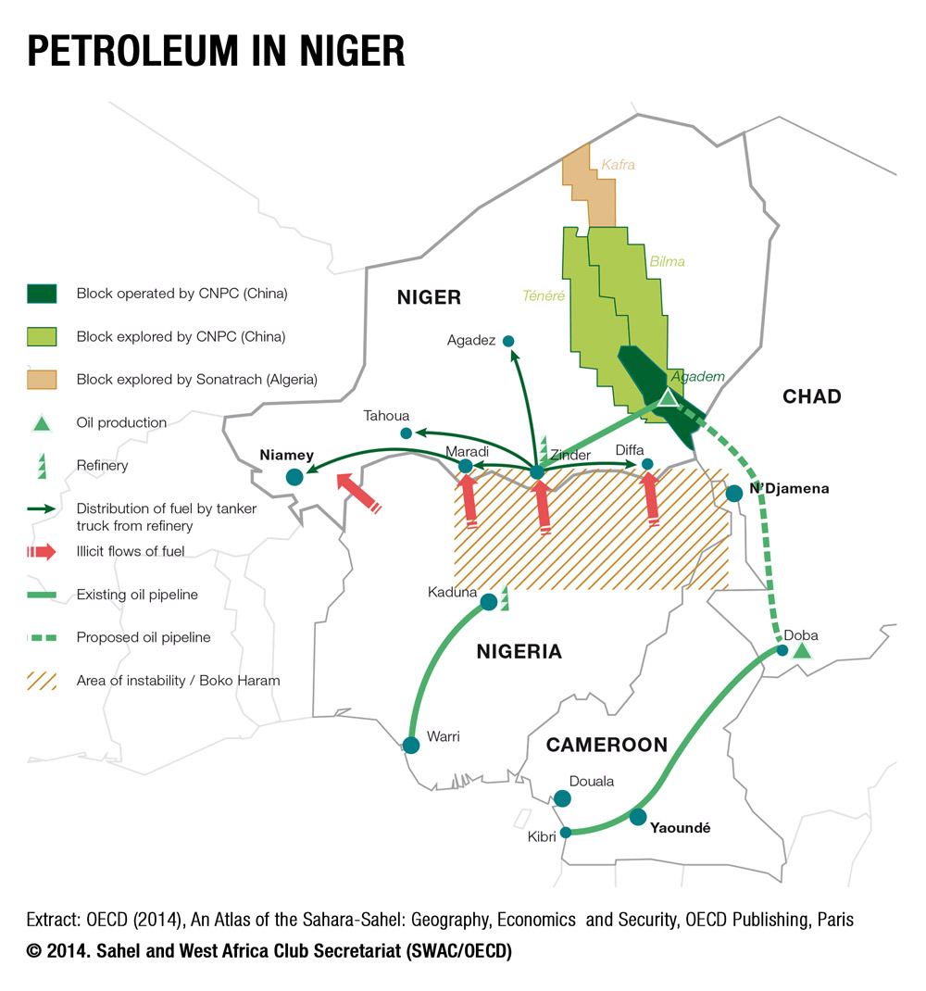

Slide 5
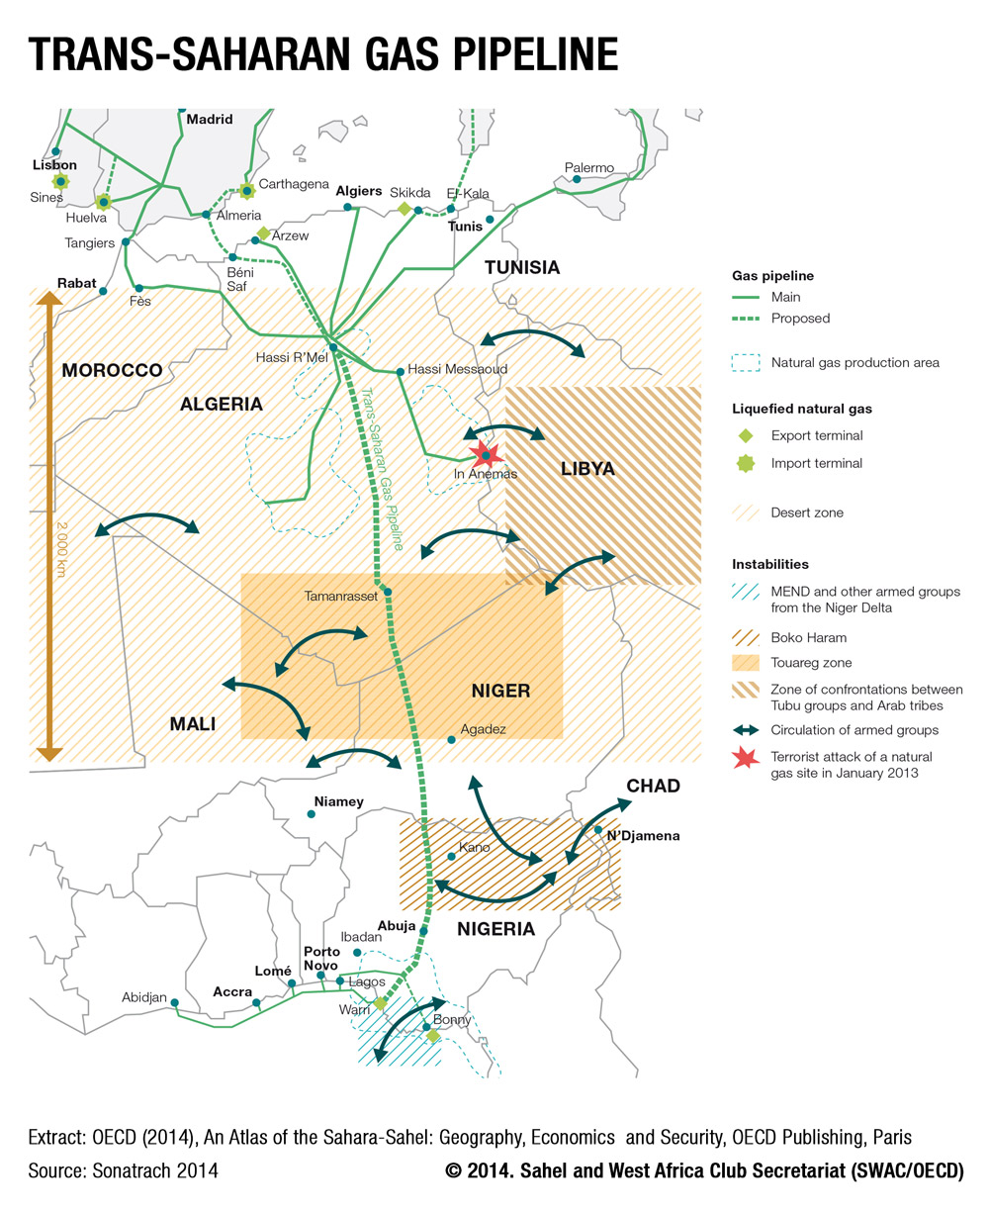

Slide 6
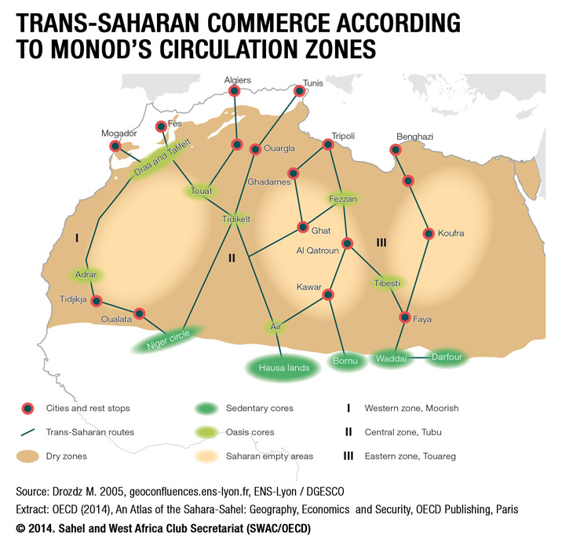

Slide 7
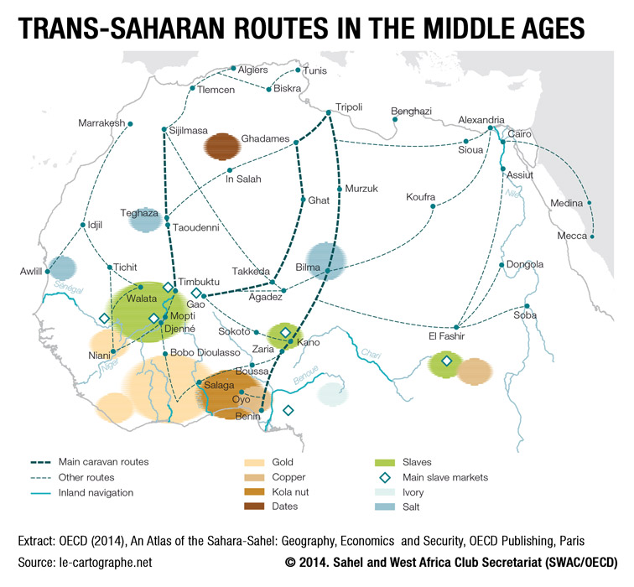

Slide 8
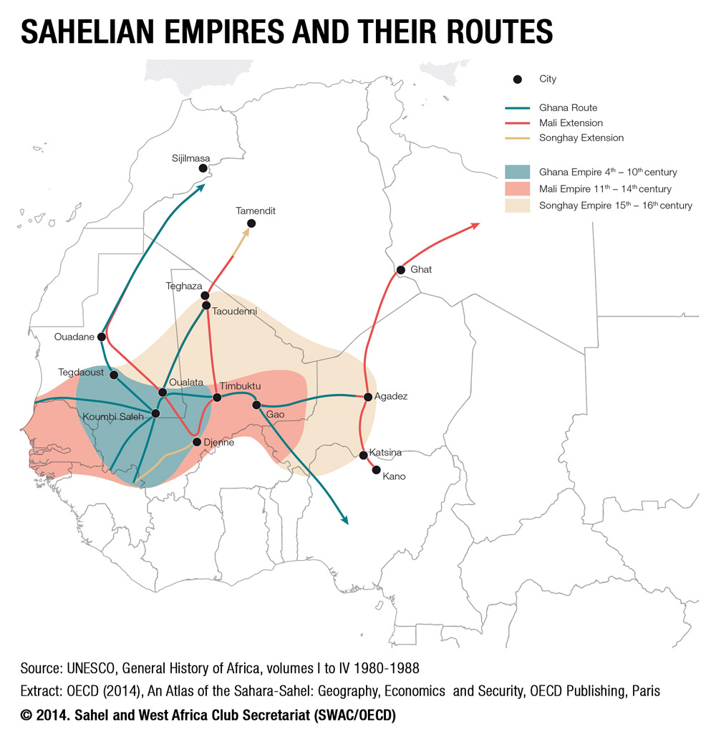

Slide 9
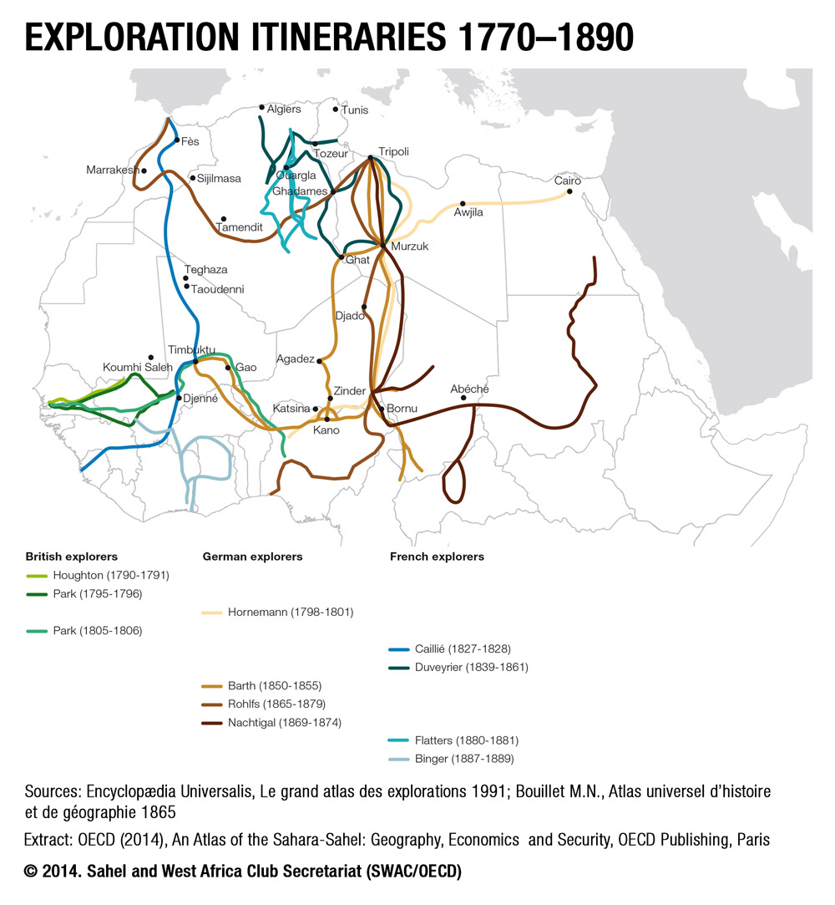

Slide 10
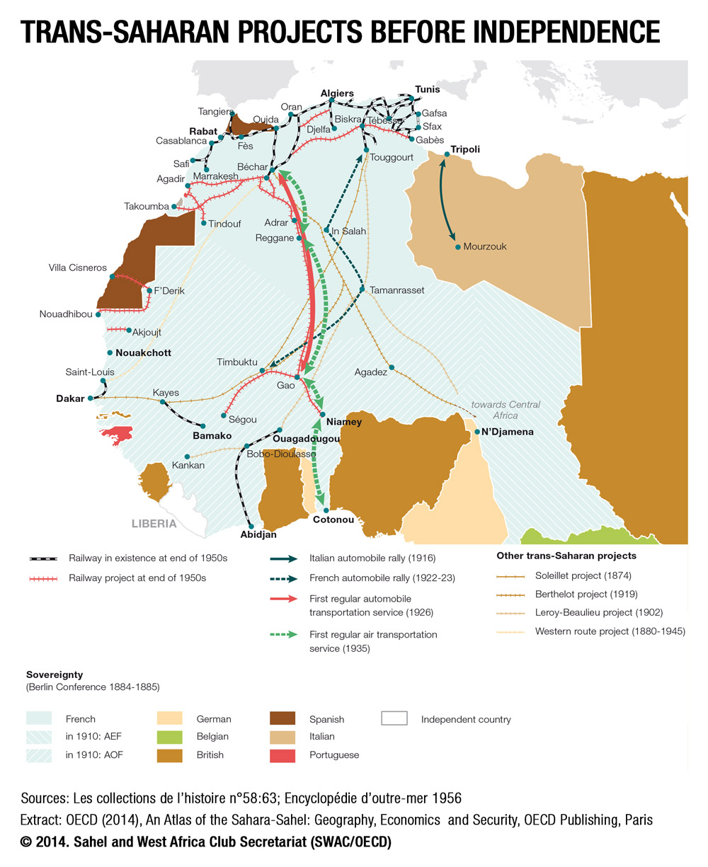

Slide 11
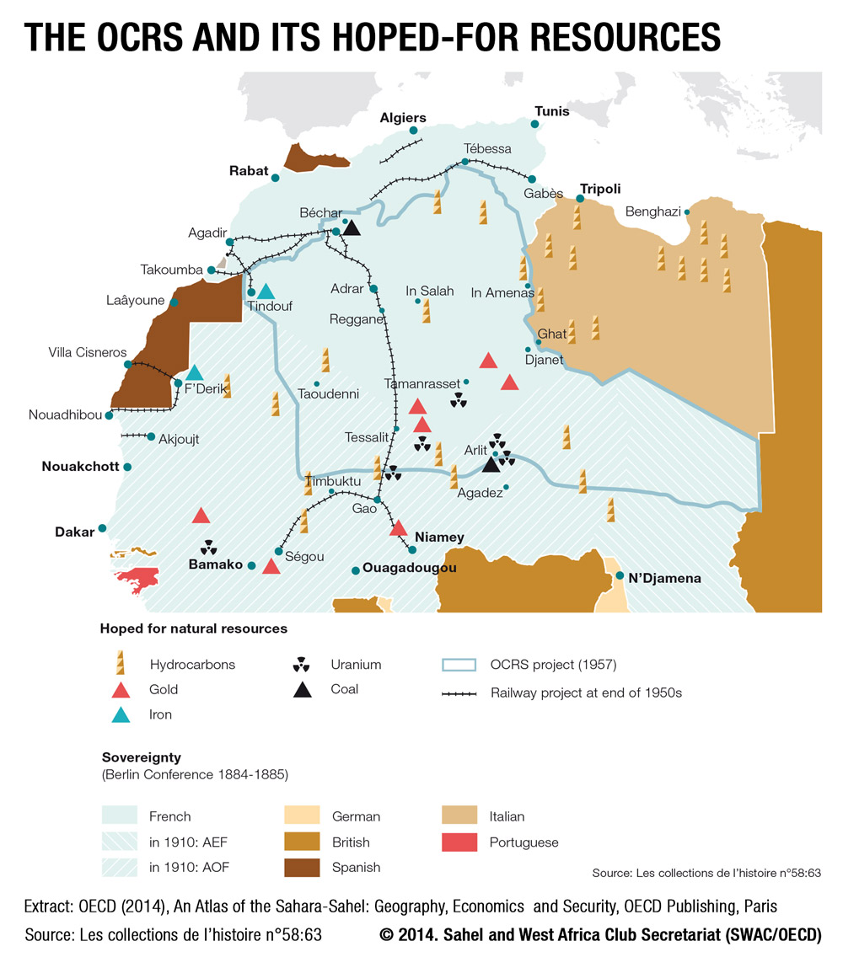

Slide 12
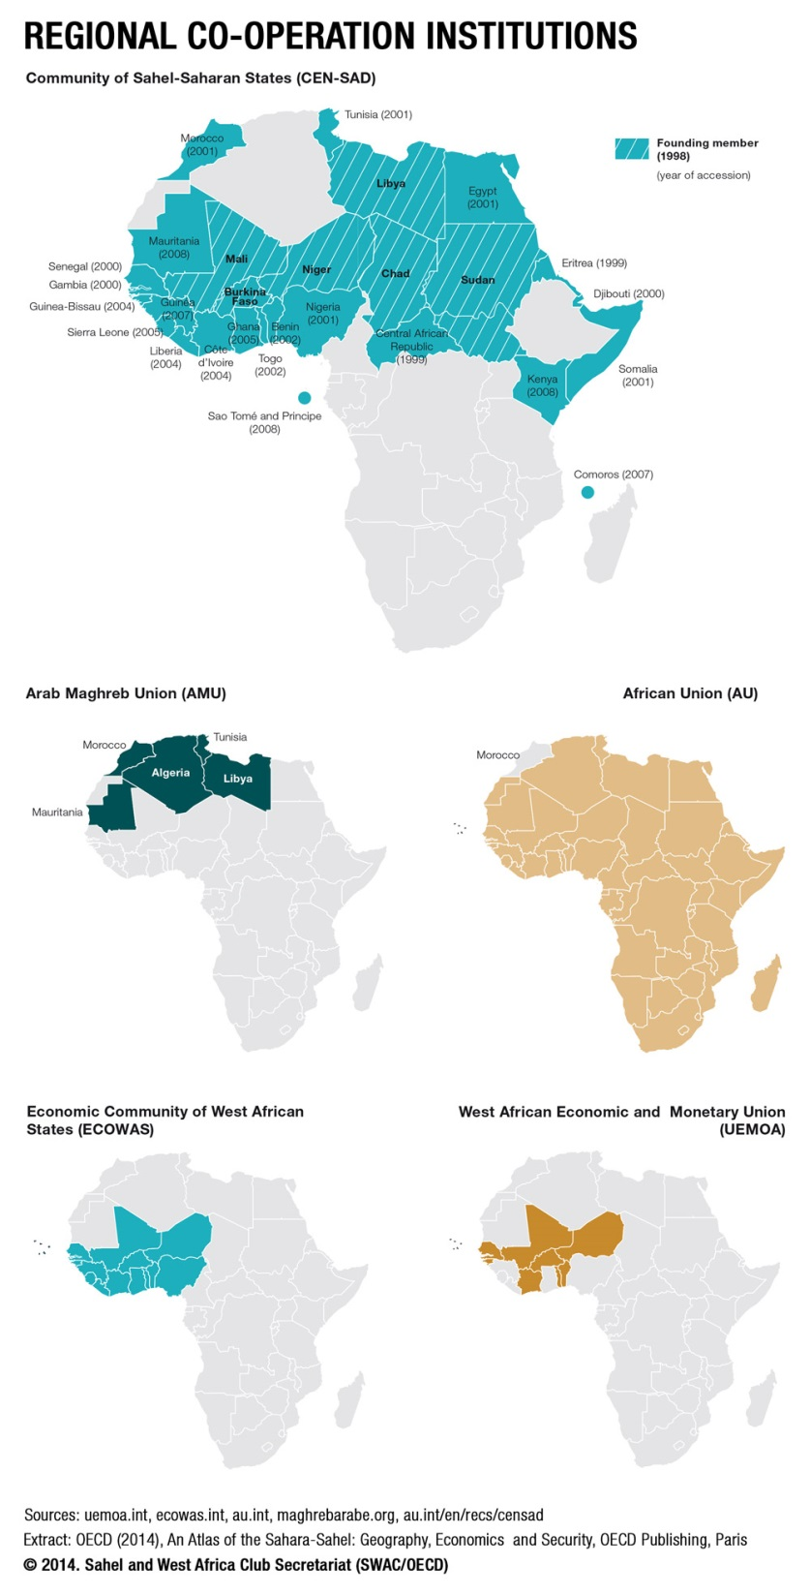

Slide 13
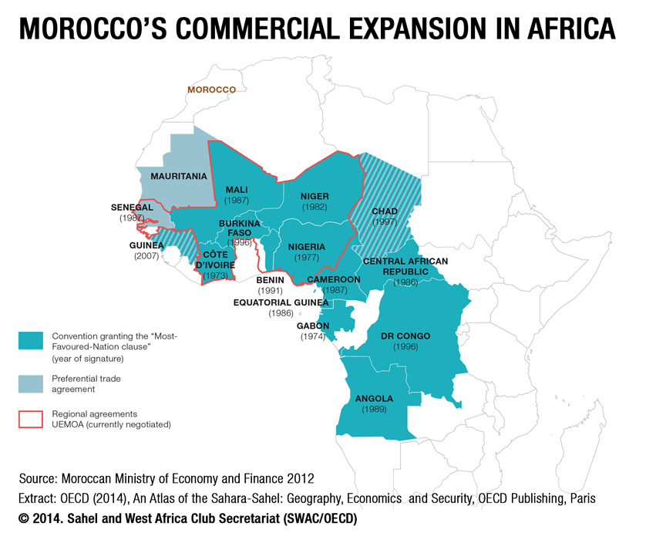

Slide 14
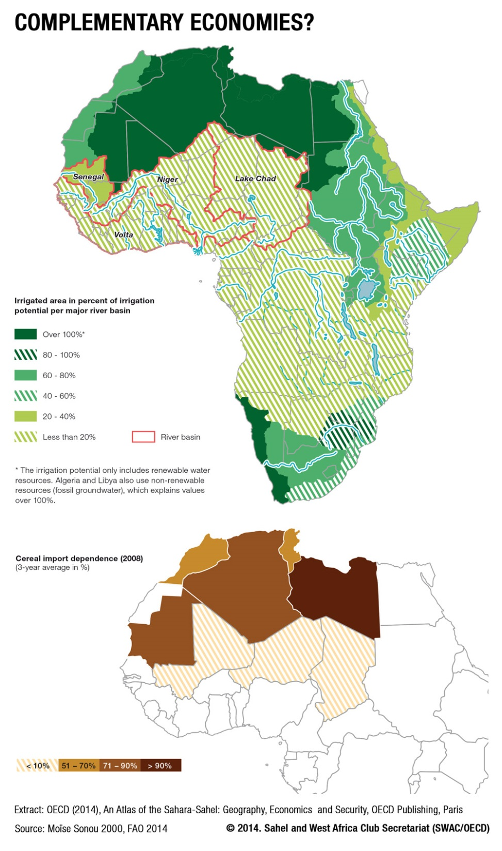

Slide 15
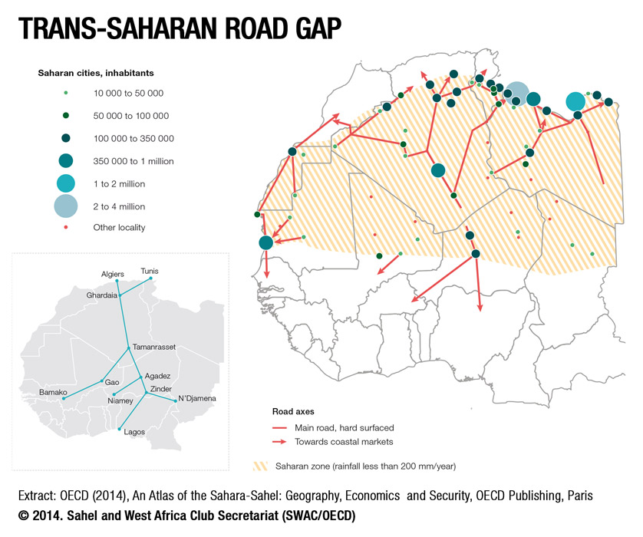

Slide 16
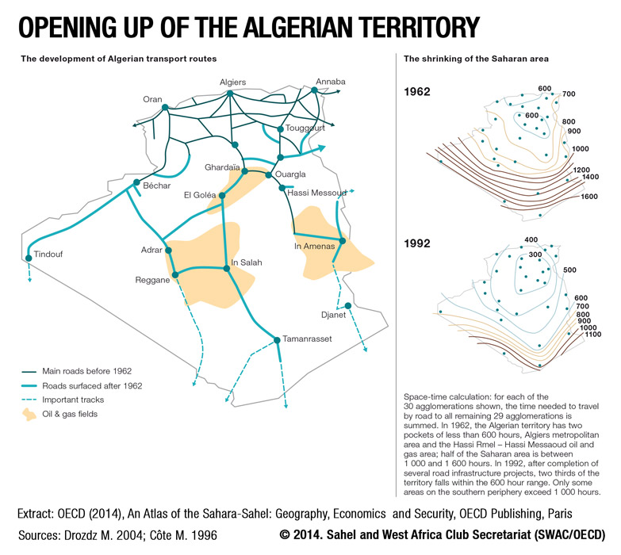

Slide 17
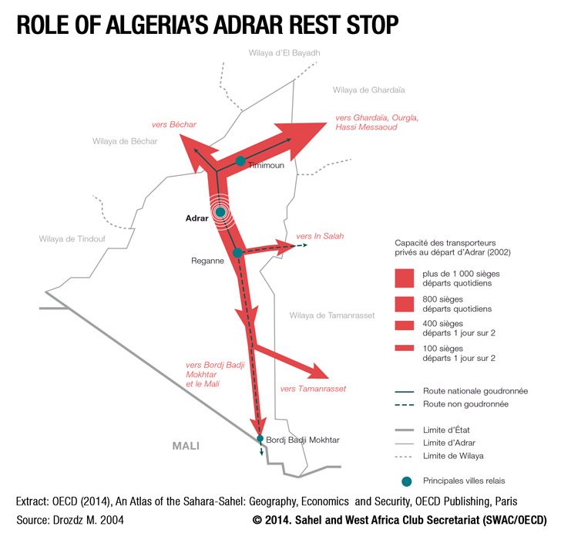

Slide 18
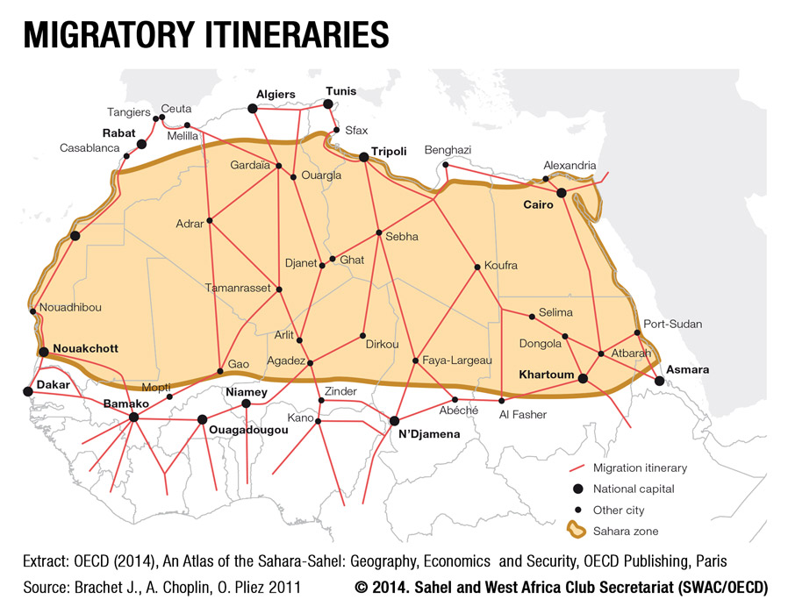

Slide 19
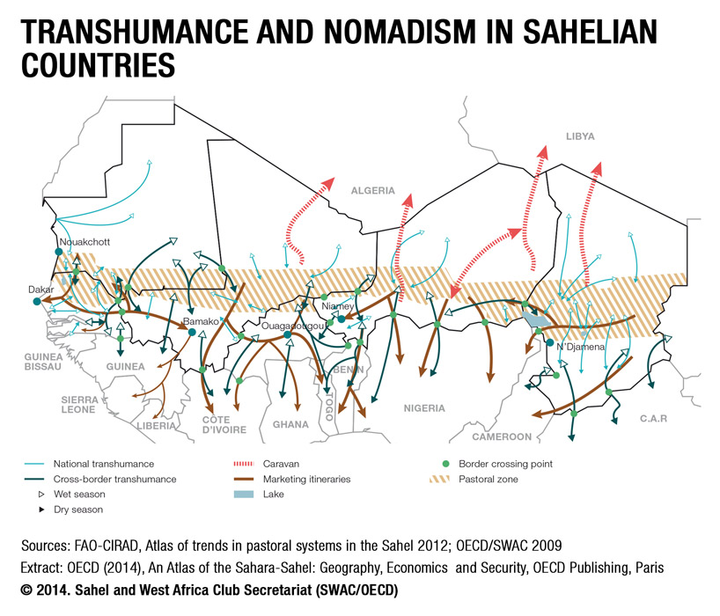

Slide 20
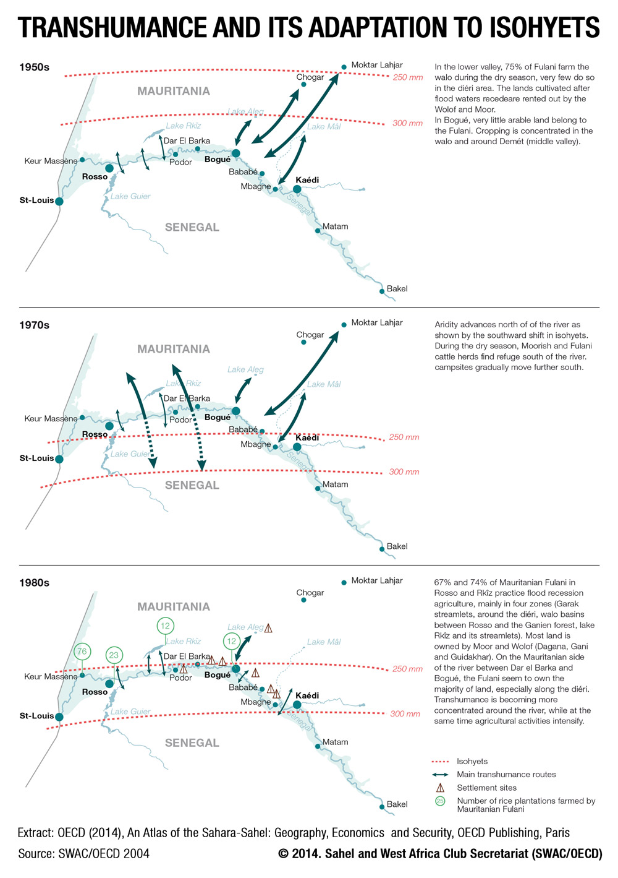

Slide 21
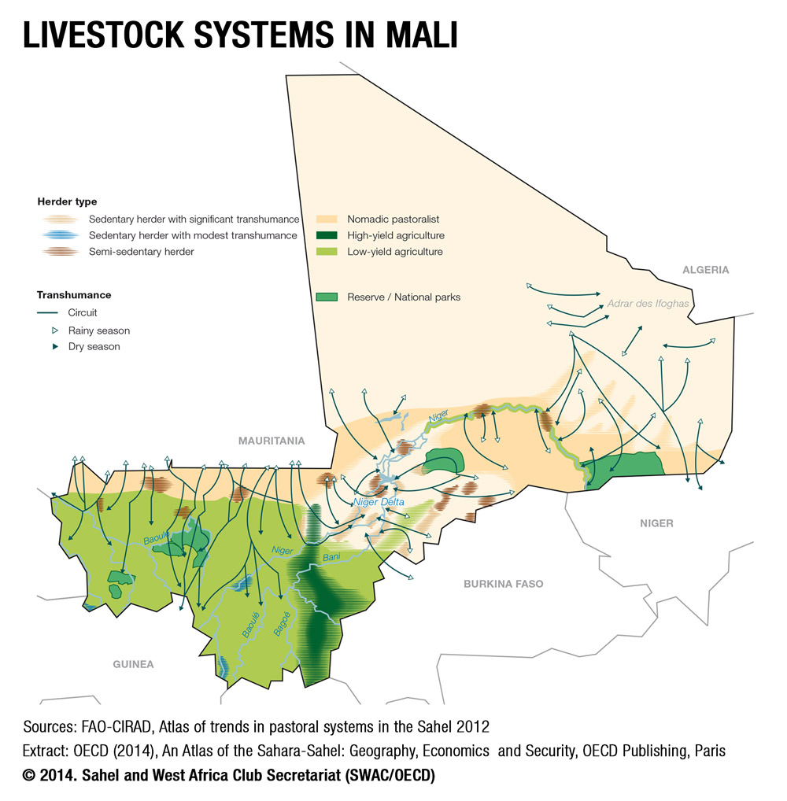

Slide 22
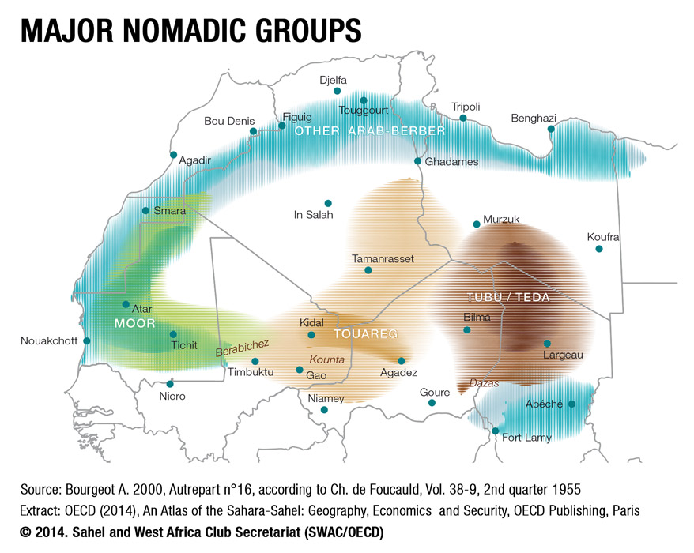

Slide 23
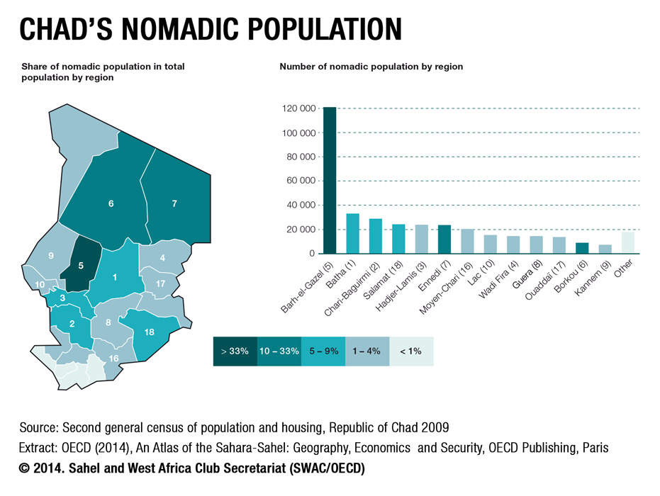

Slide 24
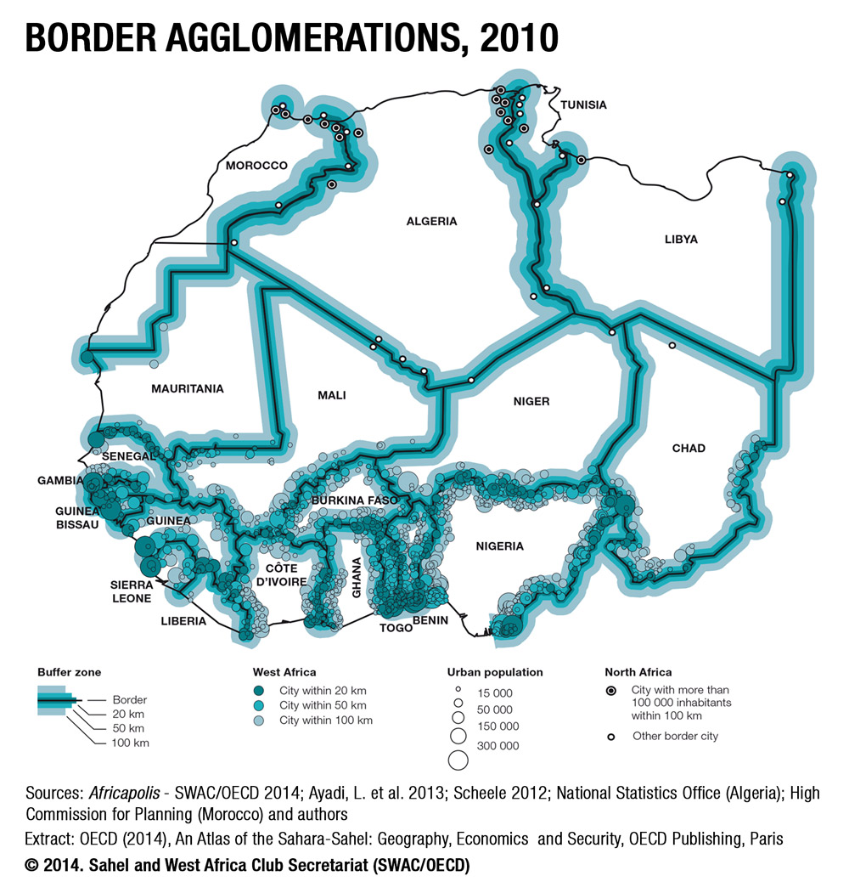

Slide 25
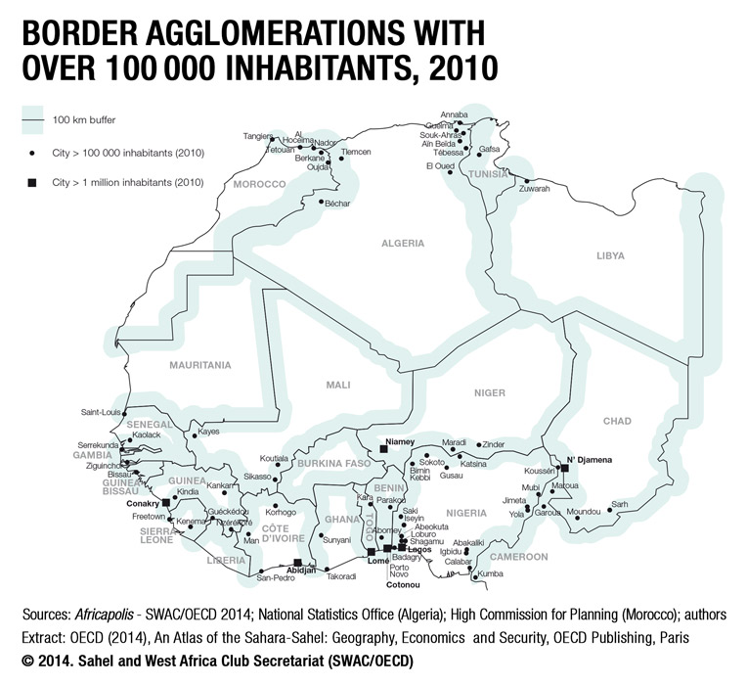

Slide 26
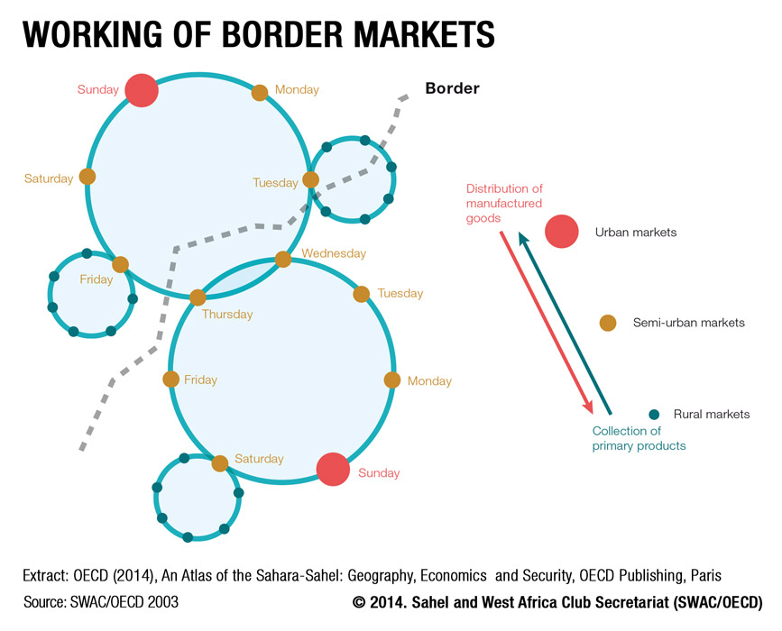

Slide 27
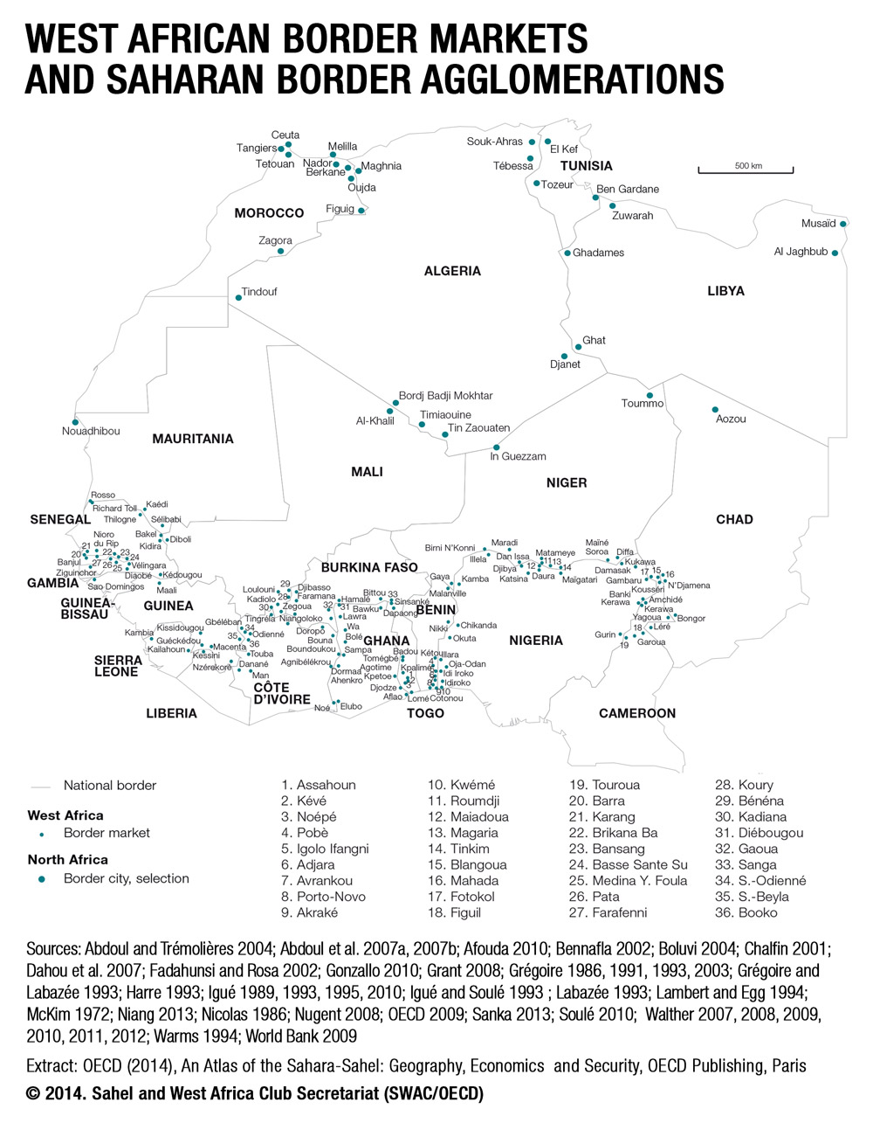
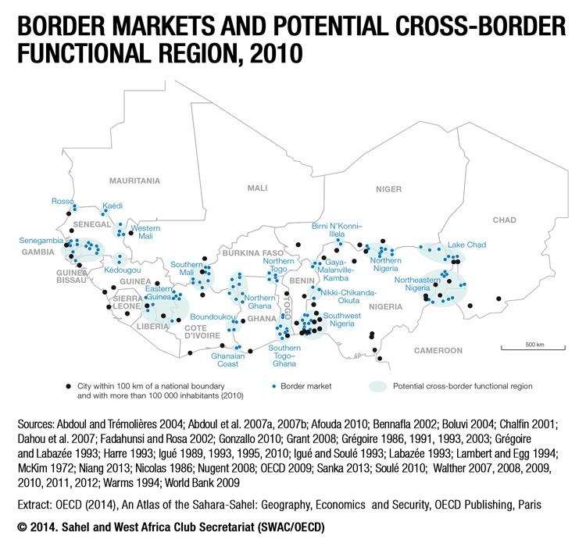

Slide 29
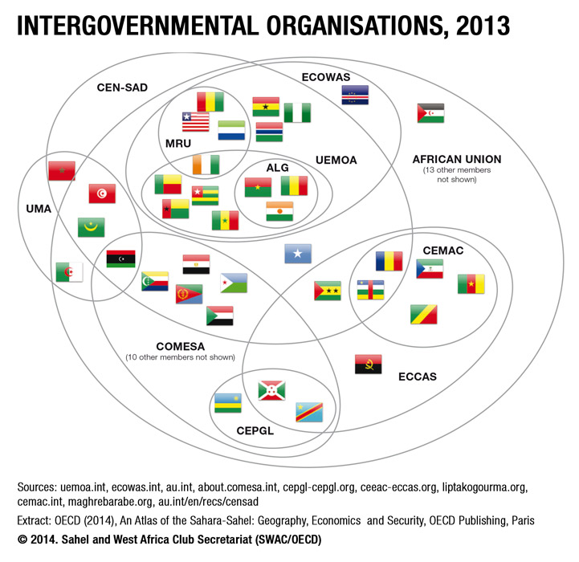

Slide 30
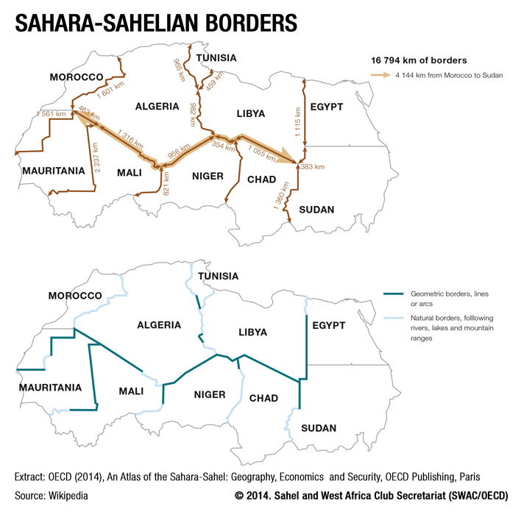

Slide 31
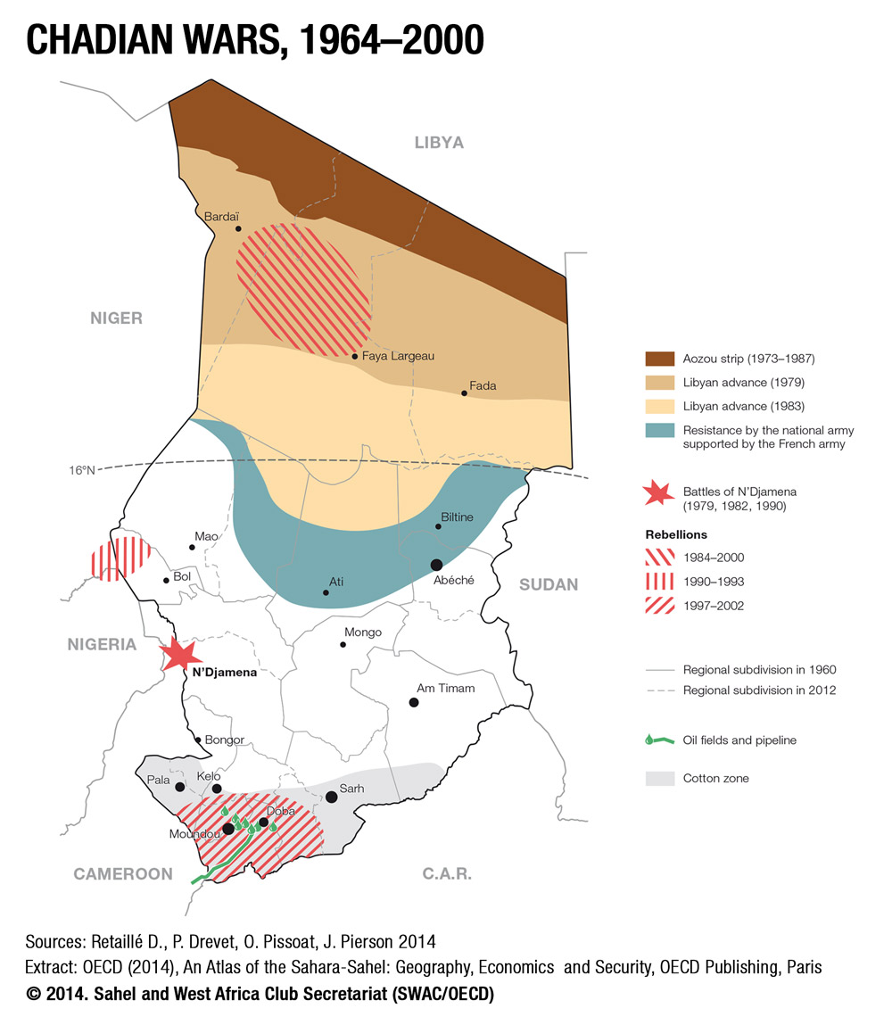

Slide 32
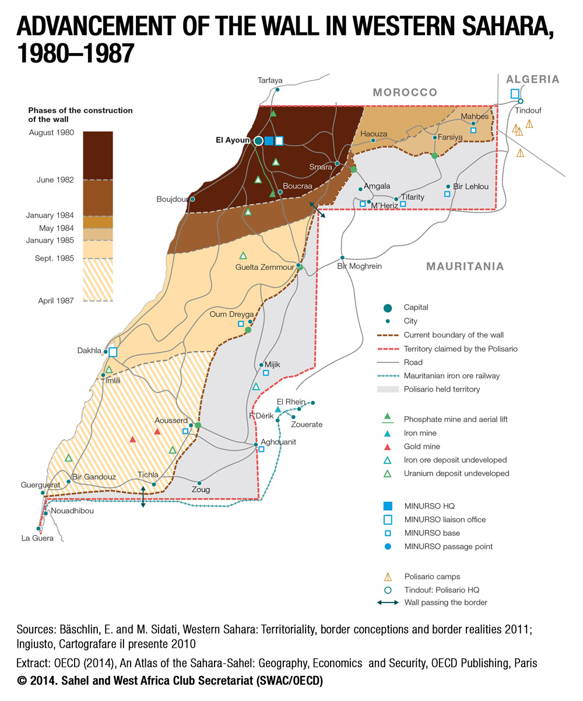

Slide 33
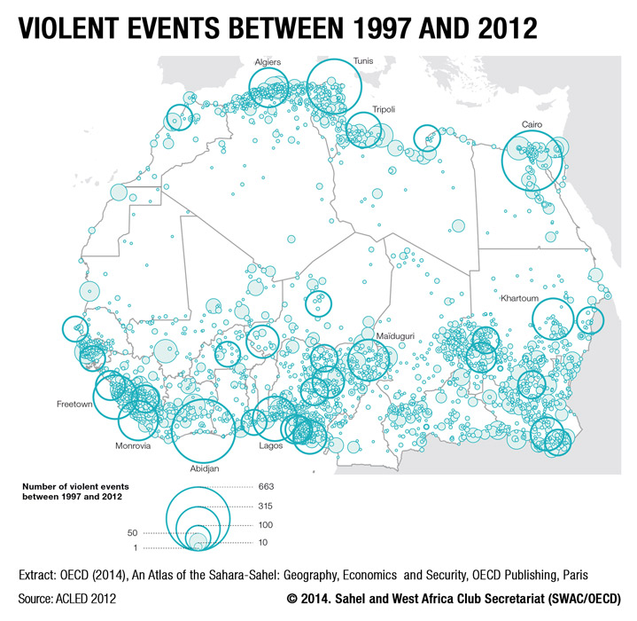

Slide 34
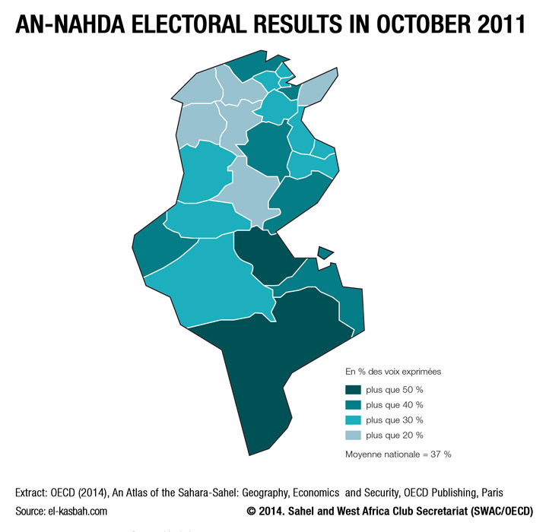

Slide 35
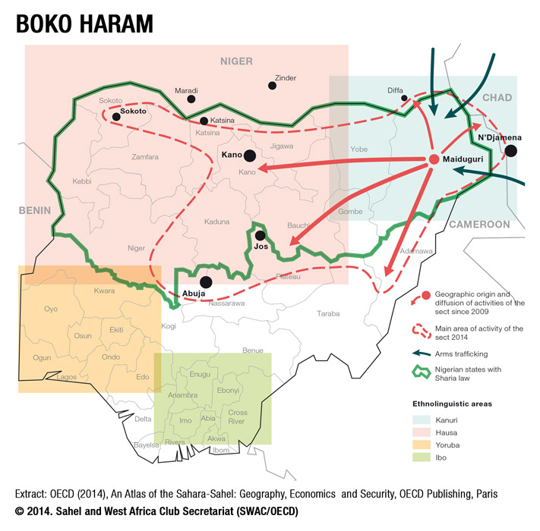

Slide 36
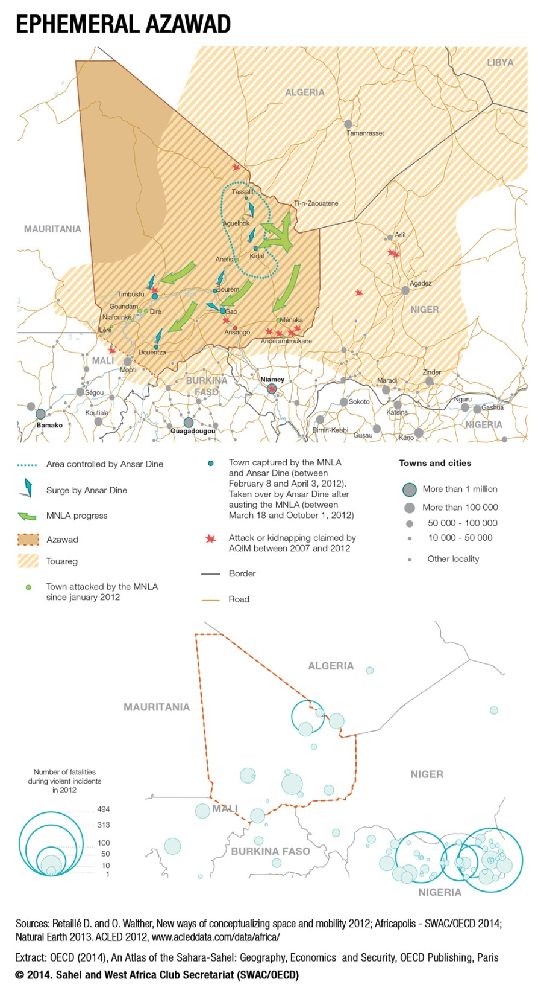

Slide 37
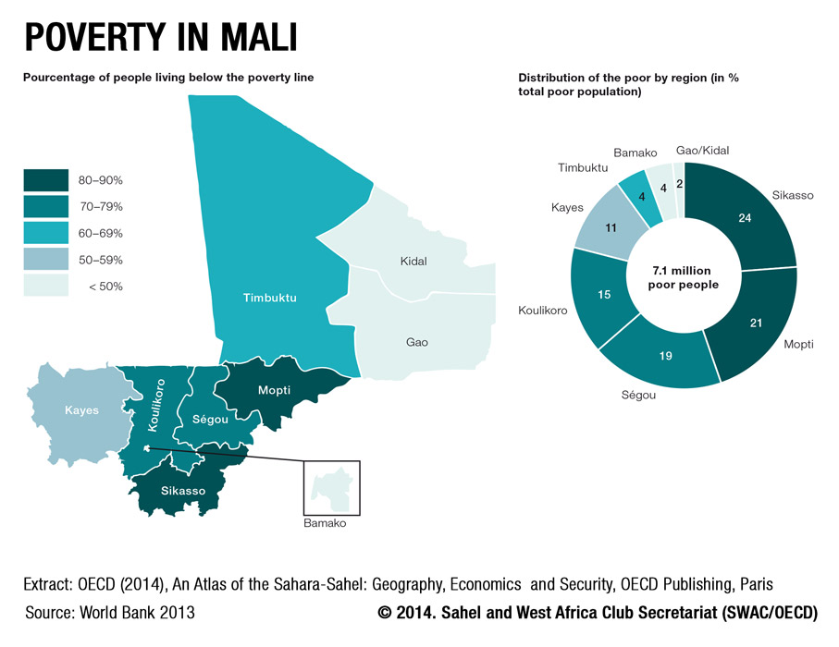

Slide 38
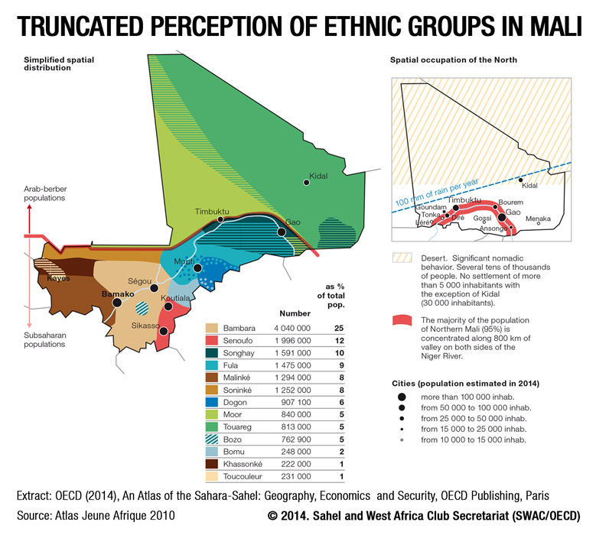

Slide 39
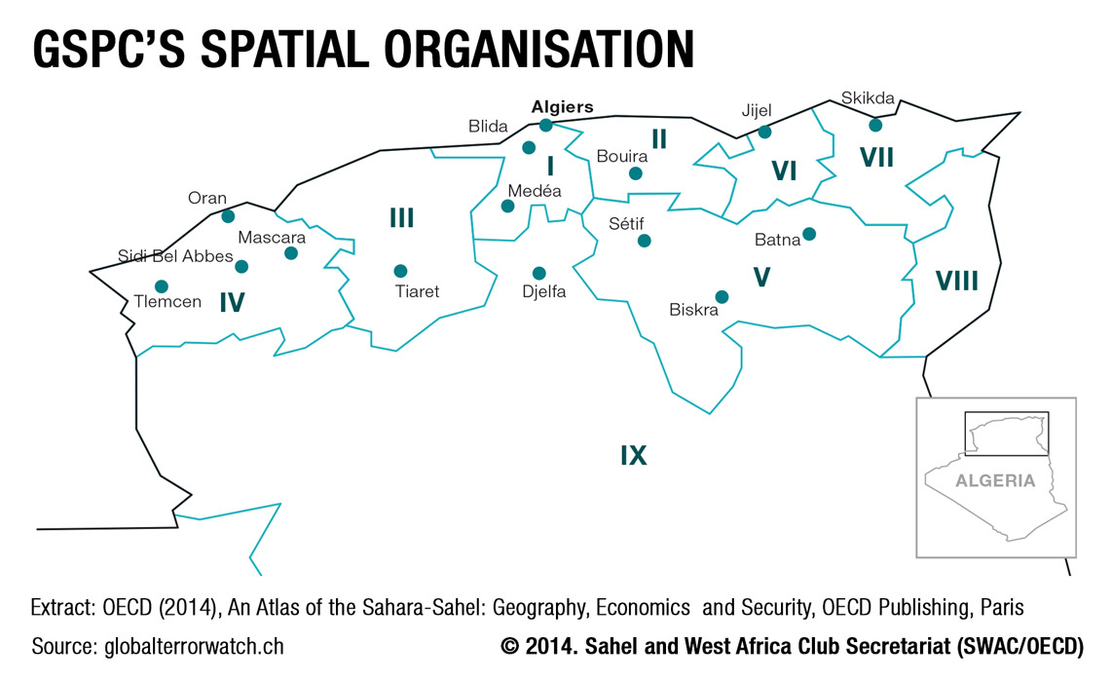

Slide 40
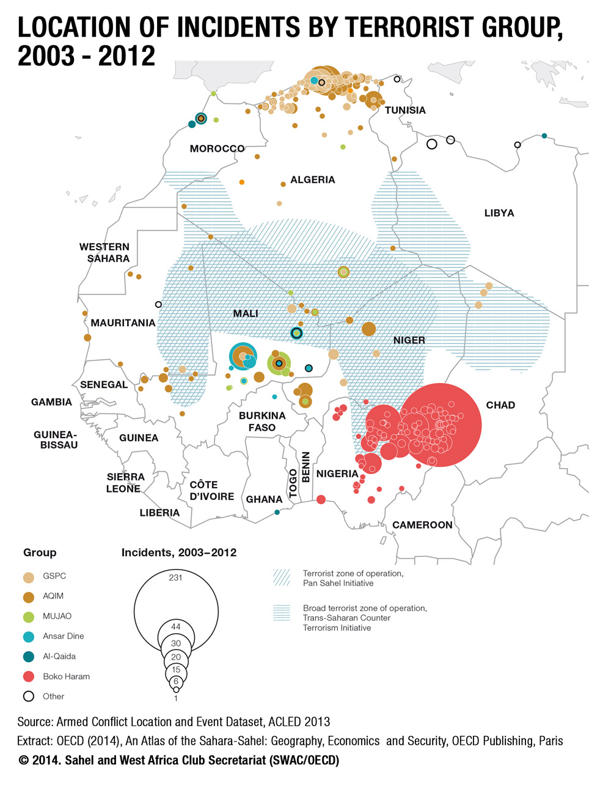

Slide 41
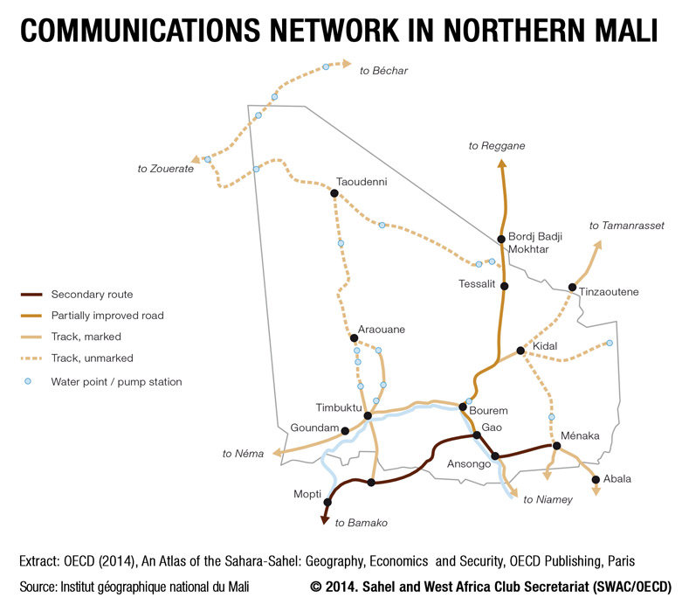

Slide 42
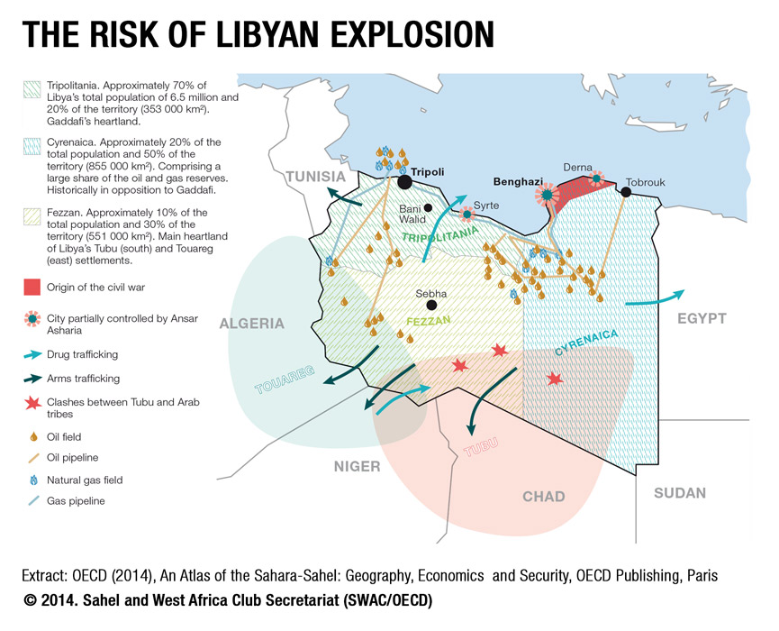

Slide 43
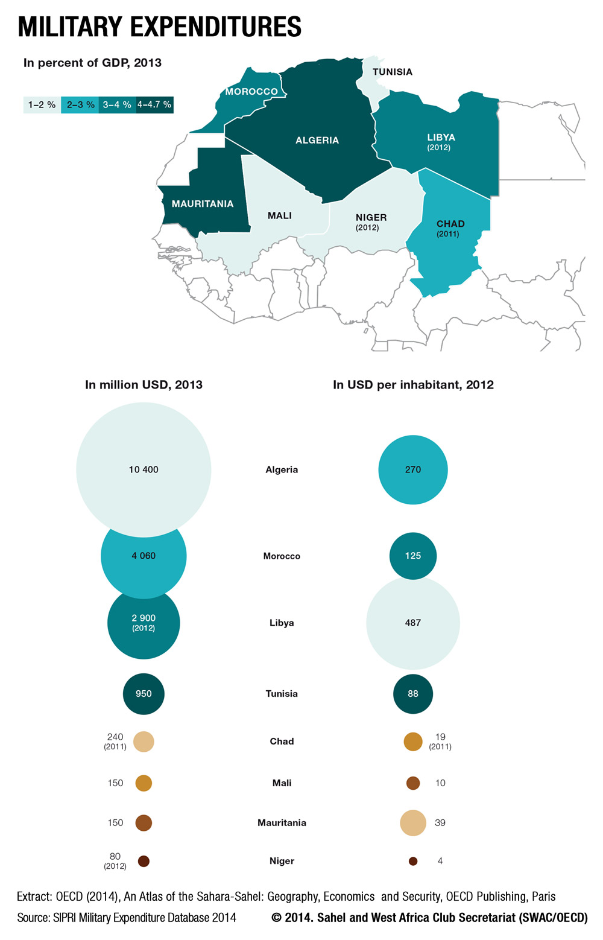

Slide 44
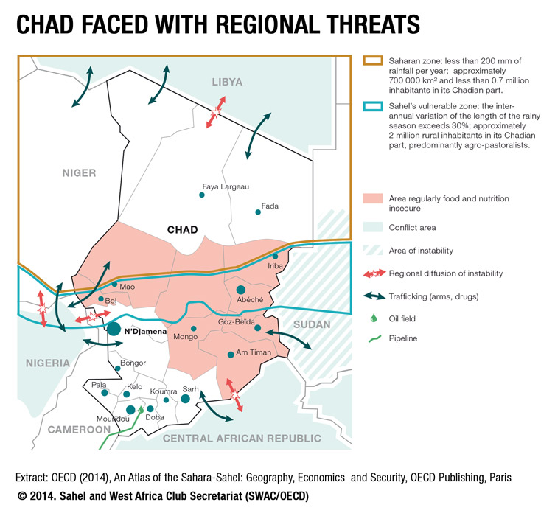

Slide 45
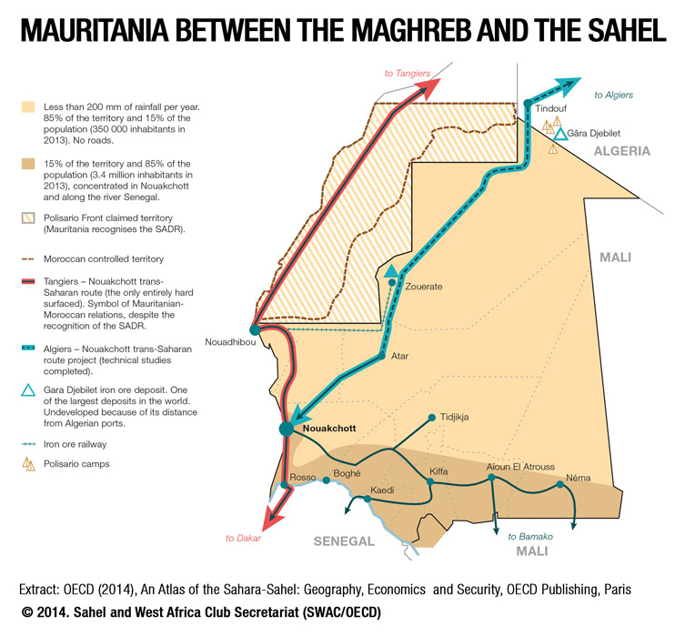

Slide 46
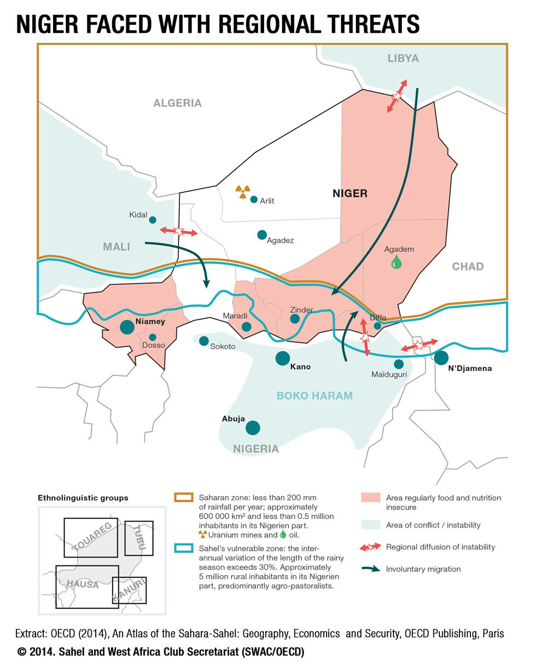

Slide 47
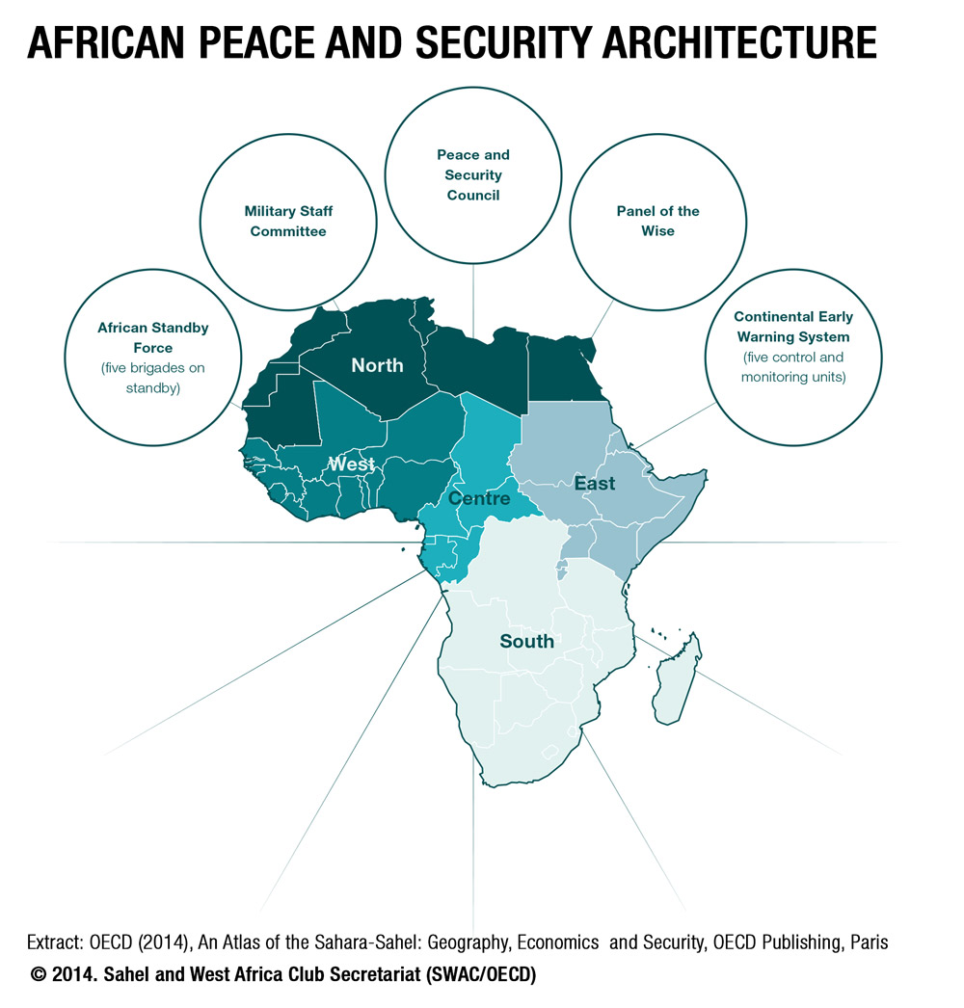

Slide 49
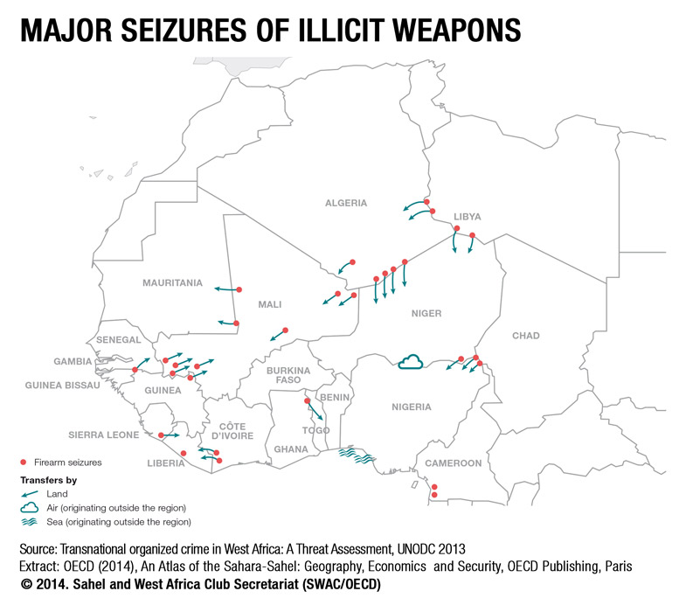

Slide 50
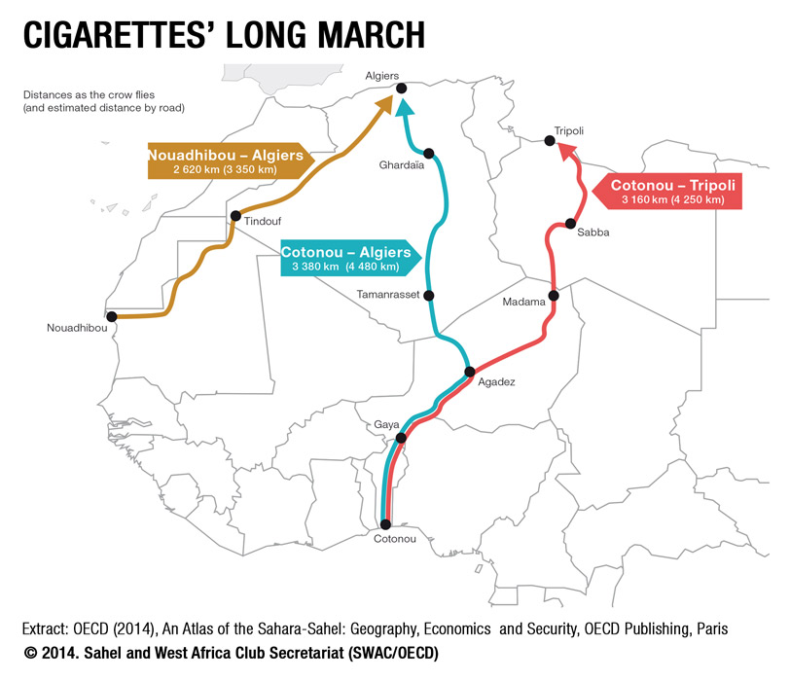

Slide 51
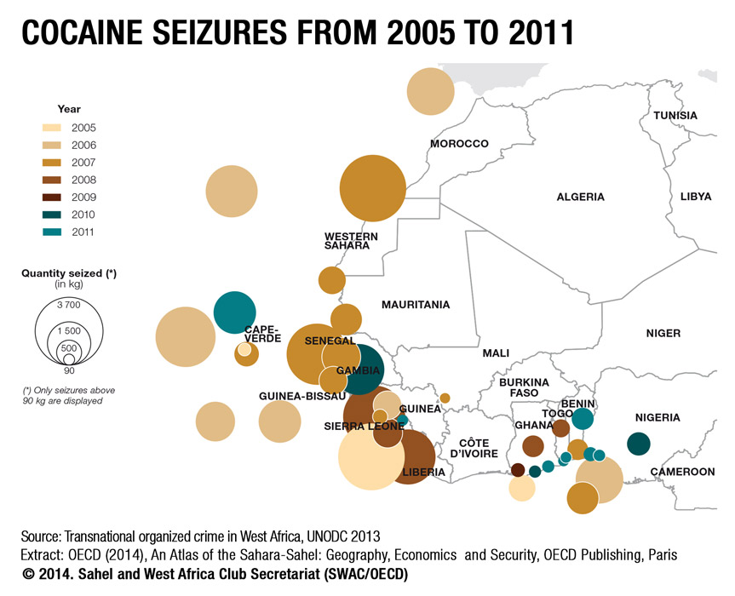

Slide 52
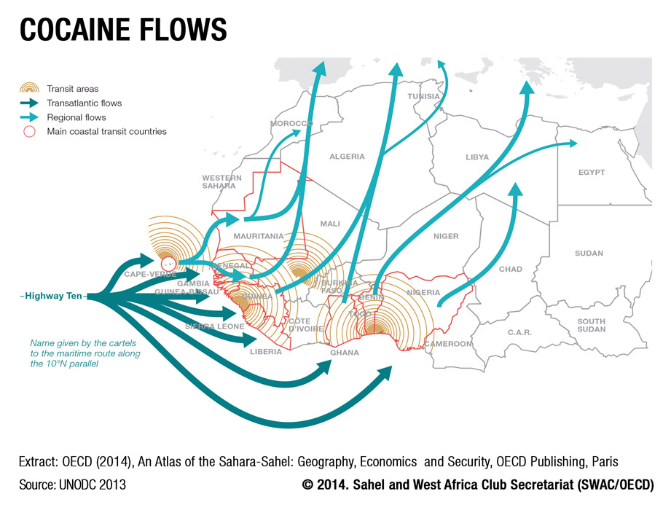

Slide 56
Atlas of the Sahara-Sahel
# | Title of Map
1 | Map 0.1 The geographic Sahel
2 | Map 0.2 The diplomatic Sahel
3 | Map 0.3 The Sahara-Sahel
4 | Map 1.1 Relief and hydrography
5 | Map 1.2 The arid area
6 | Map 1.3 The partition into administrative subdivisions
7 | Map 1.4 The partition into nation states
8 | Map 1.5 Variability of isohyets
9 | Map 1.6 The Sahel, zone of uncertainty
10 | Map 1.7 Variation in isohyets between 1940–1967 and 1968–2000
11 | Map 1.8 Coefficient of variation for annual precipitation, 1901–2006
12 | Map 1.9 The Paleo-Sahara
13 | Map 1.10 The impossibility of choosing a limit
14 | Map 1.11 Precolonial routes
15 | Map 1.12 The road network
16 | Map 1.13 City population
17 | Map 1.14 Cities in West Africa, 2010
18 | Map 1.15 The weight of history
19 | Map 1.16 Kanem Bornu
20 | Map 1.17 Almoravid and Almohad Empires
21 | Map 1.18 Ghana, Mali and Songhay Empires
22 | Map 1.19 Hinges of the Saharan region
23 | Map 1.20 Route empires
24 | Map 1.21 Border negotiations
25 | Map 1.22 Colonial empire limits in 1914
26 | Map 1.23 The process of independence
27 | Map 1.24 Population distribution
28 | Map 1.25 Population densities
29 | Map 1.26 Linear density of population
30 | Map 1.27 The impossible map (anamorphosis using inverse population density)

Slide 57
# | Title of Map
31 | Map 1.28 Mines and industries
32 | Map 1.29 Hydrocarbons
33 | Map 1.30 Metals and minerals
34 | Map 1.31 Petroleum license blocks
35 | Map 1.32 Agricultural production systems
36 | Map 1.33 Water, oases and breeding
37 | Map 1.34 The evolution of migration
38 | Map 1.35 Outsourcing of European migration policies
39 | Map 1.36 Migrants in Tamanrasset
40 | Map 1.37 The enclave of Ceuta
41 | Map 1.38 Migratory movements
42 | Map 1.39 Routes of the Paris-Dakar Rally
43 | Map 1.40 Touristic attractions
44 | Map 1.41 Touristic sites and routes
45 | Map 1.42 Violent events by type between 1997 and 2012
46 | Map 1.43 Violent events between 1997 and 2012
47 | Map 1.44 Victims of violence between 1997 and 2012
48 | Map 1.45 The actors in conflicts in 2012
49 | Map 1.46 Violent events by type in 2012
50 | Map 1.47 Areas reported on by the French Ministry of Foreign and European Affairs
51 | Map 1.48 Violent events in 2012
52 | Map 2.1 Sahara-Sahelian countries
53 | Map 2.2 Urban areas in the Sahel, 1950 – 1980 – 2010
54 | Map 3.1 Petroleum in Niger
55 | Map 3.2 The Trans-Saharan Gas Pipeline
56 | Map 4.1 Trans-Saharan commerce according to Monod’s circulation zones
57 | Map 4.2 Trans-Saharan routes in the Middle Ages
58 | Map 4.3 Sahelian empires and their routes
59 | Map 4.4 Exploration itineraries 1770–1890
60 | Map 4.5 Trans-Saharan projects before independence
61 | Map 4.6 The OCRS and its hoped-for resources
62 | Map 4.7 Regional co-operation institutions
63 | Map 4.8 Morocco’s commercial expansion in Africa
64 | Map 4.9 Complementary economies?
65 | Map 4.10 The trans-Saharan road gap

Slide 58
# | Title of Map
66 | Map 5.1 The opening up of the Algerian territory
67 | Map 5.2 The role of Algeria’s Adrar rest stop
68 | Map 5.3 Migratory itineraries
69 | Map 6.1 Transhumance and nomadism in Sahelian countries
70 | Map 6.2 Transhumance and its adaptation to isohyets
71 | Map 6.3 Livestock systems in Mali
72 | Map 6.4 Major nomadic groups
73 | Map 6.5 Chad’s nomadic population
74 | Map 7.1 Border agglomerations, 2010
75 | Map 7.2 Border agglomerations with over 100 000 inhabitants, 2010
76 | Map 7.3 The working of border markets
77 | Map 7.4 West African border markets and Saharan border agglomerations
78 | Map 7.5 Border markets and potential cross-border functional region, 2010
79 | Map 7.6 Intergovernmental organisations, 2013
80 | Map 7.7 Sahara-Sahelian borders
81 | Map 8.1 Chadian wars, 1964–2000
82 | Map 8.2 The advancement of the wall in Western Sahara, 1980–1987
83 | Map 8.3 Violent events between 1997 and 2012
84 | Map 8.4 An-Nahda electoral results in October 2011
85 | Map 8.5 Boko Haram
86 | Map 8.6 The ephemeral Azawad
87 | Map 8.7 Poverty in Mali
88 | Map 8.8 The truncated perception of ethnic groups in Mali
89 | Map 8.9 GSPC’s spatial organisation
90 | Map 8.10 Location of incidents by terrorist group, 2003–2012

Slide 59
# | Title of Map
91 | Map 8.11 Communications network in northern Mali
92 | Map 8.12 The risk of Libyan explosion
93 | Map 8.13 Military expenditures
94 | Map 8.14 Chad faced with regional threats
95 | Map 8.15 Mauritania between the Maghreb and the Sahel
96 | Map 8.16 Niger faced with regional threats
97 | Map 8.17 African peace and security architecture
98 | Map 8.18 International initiatives
99 | Map 9.1 Major seizures of illicit weapons
100 | Map 9.2 Cigarettes’ long march
101 | Map 9.3 Cocaine seizures from 2005 to 2011
102 | Map 9.4 Cocaine flows
103 | Map 9.5 Hashish flows
104 | Map 10.1 Border areas, some priorities
105 | Map 10.2 Regional security responses

